Slide 1
Module 1: Welcome to AWS Academy Cloud Architecting
AWS Academy Cloud Architecting
© 2020, Amazon Web Services, Inc. or its Affiliates. All rights reserved.
Notes:
Module 1: Welcome to AWS Academy Cloud Architecting.

Slide 2
Module overview
Sections
Course objectives and overview
Café business case introduction
Roles in cloud computing
Notes:
This module includes the following sections:
Course objectives and overview
Café business case introduction
Roles in cloud computing

Slide 3
Module objectives
At the end of this module, you should be able to:
Identify course prerequisites and objectives
Recognize the café business case
Indicate the role of cloud architects
Notes:
At the end of this module, you should be able to:
Identify course prerequisites and objectives
Recognize the café business case
Indicate the role of cloud architects

Slide 4
Section 1: Course objectives and overview
Module 1: Welcome to AWS Academy Cloud Architecting
Notes:
Introducing Section 1: Course objectives and overview.

Slide 5
Course prerequisites
Completion of the AWS Academy Cloud Foundations course
Or similar level of knowledge of Amazon Web Services (AWS), such as –
Passed the AWS Certified Cloud Practitioner certification exam or,
Completed the AWS Cloud Practitioner Essentials course or,
Completed the AWS Technical Essentials course
Additionally, it is assumed that you have –
General IT technical knowledge
General IT business knowledge
Notes:
To begin, it is important to have an understanding of the prerequisites for this course.
The curriculum in this course assumes that you previously attended the AWS Academy Cloud Foundations course. Alternatively, you might have a level of familiarity with the AWS Cloud that is similar to what the AWS Academy Cloud Foundations course provides.
It is also assumed that you have general IT technical knowledge. You must have some foundational computer literacy skills to be successful in this course. These skills include a knowledge of basic computer concepts, file management, and a good understanding of the internet.
You should also have general IT business knowledge, which includes insight into how businesses and other organizations use information technology.

Slide 6
Course objectives
After completing this course, you should be able to:
Make architectural decisions based on AWS architectural principles and best practices
Use AWS services to make your infrastructure scalable, reliable, and highly available
Use AWS managed services to enable greater flexibility and resiliency in an infrastructure
Indicate how to increase the performance efficiency and reduce costs of infrastructures built on AWS
Use the AWS Well-Architected Framework to improve architectures that use AWS solutions
Notes:
After completing this course, you should be able to:
Make architectural decisions based on AWS architectural principles and best practices
Use AWS services to make your infrastructure scalable, reliable, and highly available
Use AWS managed services to enable greater flexibility and resiliency in an infrastructure
Indicate how to increase the performance efficiency and reduce costs of infrastructures built on AWS
Use the AWS Well-Architected Framework to improve architectures that use AWS solutions

Slide 7
Course outline
Module 1 – Welcome to AWS Academy Cloud Architecting (this module)
Module 2 – Introducing Cloud Architecting
Module 3 – Adding a Storage Layer
Module 4 – Adding a Compute Layer
Module 5 – Adding a Database Layer
Module 6 – Creating a Networking Environment
Module 7 – Connecting Networks
Module 8 – Securing User and Application Access
Module 9 – Implementing Elasticity, High Availability, and Monitoring
Module 10 – Automating Your Architecture
Module 11 – Caching Content
Module 12 – Building Decoupled Architectures
Module 13 – Building Microservices and Serverless Architectures
Module 14 – Planning for Disaster
Module 15 – Bridging to Certification
Notes:
To achieve the course objectives, the course consists of the 15 modules that are shown. The next slides provide more detail on what subtopics are covered in each module.

Slide 8

Module 2: Introducing Cloud Architecting
Module sections:
What is cloud architecting?
The Amazon Web Services (AWS) Well-Architected Framework
Best practices for building solutions on AWS
AWS global infrastructure
Notes:
Module 2 introduces cloud architecting concepts. The sections in Module 2 include:
What is cloud architecting?
The Amazon Web Services (AWS) Well-Architected Framework
Best practices for building solutions on AWS
AWS global infrastructure

Slide 9

Module 3: Adding a Storage Layer
Module sections:
The simplest architecture
Using Amazon S3
Storing data in Amazon S3
Moving data to and from Amazon S3
Choosing Regions for your architecture
Notes:
Module 3 focuses on storage and Amazon S3 in particular. The sections in Module 3 include:
The simplest architecture
Using Amazon S3
Storing data in Amazon S3
Moving data to and from Amazon S3
Choosing Regions for your architecture

Slide 10

Module 4: Adding a Compute Layer
Module sections:
Architectural need
Adding compute with Amazon EC2
Choosing an Amazon Machine Image (AMI) to launch an Amazon Elastic Compute Cloud (Amazon EC2) instance
Selecting an Amazon EC2 instance type
Using user data to configure an Amazon EC2 instance
Adding storage to an Amazon EC2 instance
Amazon EC2 pricing options
Amazon EC2 considerations
Notes:
Module 4 focuses on the compute layer. The sections in Module 4 include:
Architectural need
Adding compute with Amazon Elastic Compute Cloud (Amazon EC2)
Choosing an Amazon Machine Image (AMI) to launch an Amazon EC2 instance
Selecting an Amazon EC2 instance type
Using user data to configure an Amazon EC2 instance
Adding storage to an Amazon EC2 instance
Amazon EC2 pricing options
Amazon EC2 considerations

Slide 11

Module 5: Adding a Database Layer
Module sections:
Architectural need
Database layer considerations
Amazon Relational Database Service (Amazon RDS)
Amazon DynamoDB
Database security controls
Migrating data into AWS databases
Notes:
Module 5 focuses on the database layer. The sections in Module 5 include:
Architectural need
Database layer considerations
Amazon Relational Database Service (Amazon RDS)
Amazon DynamoDB
Database security controls
Migrating data into AWS databases

Slide 12

Module 6: Creating a Networking Environment
Module sections:
Architectural need
Creating an AWS networking environment
Connecting your AWS networking environment to the internet
Securing your AWS networking environment
Notes:
Module 6 focuses on the network layer. The sections in Module 6 include:
Architectural need
Creating an AWS networking environment
Connecting your AWS networking environment to the internet
Securing your AWS networking environment

Slide 13

Module 7: Connecting Networks
Module sections:
Architectural need
Connecting to your remote network with AWS Site-to-Site VPN
Connecting to your remote network with AWS Direct Connect
Connecting virtual private clouds (VPCs) in AWS with VPC peering
Scaling your VPC network with AWS Transit Gateway
Connecting your VPC to supported AWS services
Notes:
Module 7 focuses on connecting networks. The sections in Module 7 include:
Architectural need
Connecting to your remote network with AWS Site-to-Site VPN
Connecting to your remote network with AWS Direct Connect
Connecting virtual private clouds (VPCs) in AWS with VPC peering
Scaling your VPC network with AWS Transit Gateway
Connecting your VPC to supported AWS services

Slide 14

Module 8: Securing User and Application Access
Module sections:
Architectural need
Account users and AWS Identity and Access Management (IAM)
Organizing users
Federating users
Multiple accounts
Notes:
Module 8 focuses on securing user and application access. The sections in Module 8 include:
Architectural need
Account users and AWS Identity and Access Management (IAM)
Organizing users
Federating users
Multiple accounts

Slide 15

Module 9: Implementing Elasticity, High Availability, and Monitoring
Module sections:
Architectural need
Scaling your compute resources
Scaling your databases
Designing an environment that’s highly available
Monitoring
Notes:
Module 9 focuses on implementing elasticity, high availability, and monitoring. The sections in Module 9 include:
Architectural need
Scaling your compute resources
Scaling your databases
Designing an environment that's highly available
Monitoring

Slide 16

Module 10: Automating Your Architecture
Module sections:
Architectural need
Reasons to automate
Automating your infrastructure
Automating deployments
AWS Elastic Beanstalk
Notes:
Module 10 focuses on automating your architecture. The sections in Module 10 include:
Architectural need
Reasons to automate
Automating your infrastructure
Automating deployments
AWS Elastic Beanstalk

Slide 17

Module 11: Caching Content
Module sections:
Architectural need
Overview of caching
Edge caching
Caching web sessions
Caching databases
Notes:
Module 11 focuses on caching content. The sections in Module 11 include:
Architectural need
Overview of caching
Edge caching
Caching web sessions
Caching databases

Slide 18

Module 12: Building Decoupled Architectures
Module sections:
Architectural need
Decoupling your architecture
Decoupling with Amazon Simple Queue Service (Amazon SQS)
Decoupling with Amazon Simple Notification Service (Amazon SNS)
Sending messages between cloud applications and on-premises with Amazon MQ
Notes:
Module 12 focuses on building decoupled architectures. The sections in Module 12 include:
Architectural need
Decoupling your architecture
Decoupling with Amazon Simple Queue Service (Amazon SQS)
Decoupling with Amazon Simple Notification Service (Amazon SNS)
Sending messages between cloud applications and on-premises with Amazon MQ

Slide 19

Module 13: Building Microservices and Serverless Architectures
Module sections:
Architectural need
Introducing microservices
Building microservice applications with AWS container services
Introducing serverless architectures
Building serverless architectures with AWS Lambda
Extending serverless architectures with Amazon API Gateway
Orchestrating microservices with AWS Step Functions
Notes:
Module 13 focuses on building microservices and serverless architectures. The sections in Module 13 include:
Architectural need
Introducing microservices
Building microservice applications with AWS container services
Introducing serverless architectures
Building serverless architectures with AWS Lambda
Extending serverless architectures with Amazon API Gateway
Orchestrating microservices with AWS Step Functions

Slide 20

Module 14: Planning for Disaster
Module sections:
Architectural need
Disaster planning strategies
Disaster recovery patterns
Notes:
Module 14 focuses on disaster planning. The sections in Module 14 include:
Architectural need
Disaster planning strategies
Disaster recovery patterns

Slide 21


Module 15: Bridging to Certification
Module sections:
Certification exam resources
Additional resources
Notes:
Module 15 focuses on bridging your learning in this course to attaining an AWS certification. The sections in Module 15 include:
Certification exam resources
Additional resources

Slide 22
Section 2: Café business case introduction
Module 1: Welcome to AWS Academy Cloud Architecting
Notes:
Introducing Section 2: Café business case introduction.

Slide 23


Café and bakery
Notes:
The challenge labs in this course are built around a fictional business case. The business case provides a way to explore cloud-computing topics in the context of relatable business needs. This scenario is intended to provide an example of the real-world applicability of technical concepts that you will learn.
Frank and Martha opened a café and bakery that had its start from a retirement dream. Frank and Martha were not yet ready to live out their retirement around the house. Instead, they wanted to do something that included their love of baking and supplemented their income. They enjoy interacting with the people in their neighborhood. They also like to support community events across town with their baked goods and coffees.
To make their dreams a reality, Frank and Martha recently decided to open their café and bakery at the base of their flat. Their daughter, Sofía, and a local school student, Nikhil, help out and work at the café. Since they opened the café, they have experienced an increase in local business. They also sometimes receive inquiries from people who travel through the area either for business or as tourists.

Slide 24




The café owners and staff
Frank
Co-owner of café
Retired from Navy
Likes to bake
Non-technical
Sofía
Daughter of Frank and Martha
Manages the café’s supply chain
Technical skills, including programming, future business administration student
Started to use AWS
Martha
Co-owner of café
Retired accountant
Knows how to use spreadsheets, otherwise non-technical
Nikhil
Café employee, visual design skills
Interested in learning cloud computing
Might take on more responsibilities at the café when Sofía starts her studies at the university
Notes:
Sofía is the daughter of Frank and Martha. She runs the café, which includes managing the supply chain for sourcing ingredients and tracking inventory. She took some programming classes in secondary school and plans to start working toward a university degree in business administration later this year. Sofía just learned about Amazon Web Services. She has talked to her parents about how they could use AWS services to automate some aspects of the café business, reduce manual administrative work, and improve the customer experience. Nikhil works at the café part time. He is going to finish secondary school in the spring. He works behind the counter, serving customers and doing other tasks under Sofía’s supervision. He has some experience with visual design, and wants to learn more about web development and cloud computing. He plans to get a university degree that will build his existing design skills, and also enable him to learn cloud computing skills.

Slide 25



AWS consultants, café visitors
Olivia
An AWS solutions architect
Technical, with a specialty in databases and network technologies
Mateo
Systems administrator and engineer
Likes to find ways to automate and to create repeatable solutions
Knows the importance of backups and disaster recovery in solution design
Faythe
Developer, experienced with AWS programming interfaces
Knowledgeable about cloud security
Notes:
Olivia is an AWS solutions architect (SA) who recently moved to the downtown area. She frequently visits the café and enjoys talking with Sofía. Through their conversations, Sofía has learned that Olivia is an expert in AWS and cloud technologies. Olivia used to be a network engineer, and she also has a strong background in database technologies. Faythe is an AWS developer who recently completed an AWS internship program. She likes to use her programming skills to apply the appropriate technology to a business problem. She recently achieved the AWS Certified Security – Specialty and is interested in developing big data solutions. Faythe is friends with Olivia and Mateo, and she also frequently visits the café. Mateo is an experienced AWS SysOps engineer. He is skilled at bringing automation and fault tolerance to the solutions that he builds. He also likes to design for backup and disaster recovery. Mateo previously worked as a developer, and has been mentoring Faythe since she started as an intern with AWS. Mateo is happy to help Faythe and anyone who is interested in learning. Mateo is friends with Nikhil, Sofía, Olivia, and Faythe, and he frequently grabs a coffee at the café on his way to work.

Slide 26


You will build solutions for the café in the challenge labs in this course
The café has business needs that can be solved with cloud computing architectures.
The café employees and the consultants often socialize and share cloud architecture ideas.
Notes:
In the hands-on labs in this course, you gain hands-on practice building on AWS. Two types of labs are available: guided labs and challenge labs.
Guided labs provide you with step-by-step instructions, to help you gain experience in creating and configuring AWS resources in the different AWS service areas. The guided labs do not mention the café business; however, the skills that you gain in these guided labs prepare you for the challenge labs.
The challenge labs present new business requirements that are based on the evolving needs of the café. These labs contain sections where the instructions do not provide full click-level guidance or detailed step-by-step instructions. Rather, you will be challenged to apply the skills that you gained from the guided labs and the concepts that are presented in the lectures.
In the challenge labs, you take on the role of Sofía or Nikhil. With the assistance of the AWS consultants who occasionally pass through the café offering advice, you will architect cloud solutions that help fulfill the business needs of the café.

Slide 27
Section 3: Roles in cloud computing
Module 1: Welcome to AWS Academy Cloud Architecting
Notes:
Introducing Section 3: Roles in cloud computing.

Slide 28

Roles in computing: IT professional
IT professional
Generalist, might manage an application
Often manages a production environment
Highly technical
Might have significant or limited experience in cloud technologies
Might specialize in one area (such as security or storage)
Job titles: IT Administrator, Systems Administrator, Network Administrator
Notes:
In this section, you will learn about five common roles in cloud computing.
You might want to start your career in cloud computing, or to transition your career to a cloud computing role. Maybe you would like to work in an organization where some employees have cloud computing responsibilities. For any of these reasons, it is helpful to understand the common job titles or roles that individuals, teams, or departments perform.
IT professionals are generalists. They typically have a broad range of skills. For example, they might manage the infrastructure for an entire application and have a strong understanding of the components that make up the solution. However, they might not always have detailed knowledge of any one service that is part of the application. IT professionals are typically highly technical.
Common job titles include IT Administrator, Systems Administrator, or Network Administrator.

Slide 29

Roles in computing: IT leader
IT leader
Leads a team of IT professionals
Responsible for day-to-day operations
Manages a budget, stays informed about and chooses new technologies
Hands on during early stages of a project, then delegates the team to take over
Job titles: IT Manager, IT Director, IT Supervisor
Notes:
IT leaders are managers. They typically lead a team of IT professionals, and decide on the type of technology that will be used for a project. They might be significantly involved in the implementation details early on in the project lifecycle. Then, they delegate the team to handle the details as the project gets closer to completion.
Typical job titles include IT Manager, IT Director, and IT Supervisor.

Slide 30

Roles in computing: Developer
Developer
Writes, tests, and fixes code
Thinks about projects at the application level
Likes sample code
Works with APIs, SDKs
Job titles: Software Developer, System Architect, Software Development Manager
Notes:
Another common role in cloud computing is the developer role. Developers like to code. They work with the details—writing, testing, and fixing the code that makes an application work. Developers are likely to borrow ideas from sample code. They work with application programming interfaces (APIs) and software development kits (SDKs).
Common job titles include Software Developer, Systems Architect, or Software Development Manager.

Slide 31

Roles in computing: DevOps engineer
DevOps engineer
Builds out the infrastructure that applications run on, often in the cloud
Follow the guidelines of the cloud architect
Prefer experimenting and trying things out rather than lots of reading
Job titles: DevOps Engineer, Reliability Engineer, Build Engineer
Notes:
DevOps engineers spend their time building out the infrastructure that applications run on. They often create or improve on the code that installs and configures servers and application deployments. DevOps staff prefer to experiment and learn by doing. They create repeatable deployment solutions, and they work to apply engineering skills to the business needs of operations teams.
Common job titles include DevOps Engineer, Build Engineer, or Reliability Engineer.

Slide 32

Roles in computing: Cloud architect
Cloud architect
Stays up-to-date with new technologies, helps decide which to use
Provides documentation, processes, and tooling to developers
Gives developers freedom to innovate
Common challenges include –
Resource management
Cost optimization
Defining best practices for performance, reliability, and security
Job titles: Cloud Architect, Systems Engineer, Systems Analyst
Notes:
The final cloud computing role that you will learn about in this section is the cloud architect role.
Cloud architects spend their time reading and staying up-to-date with the latest developments and trends in cloud computing. They are responsible for the design architecture of applications and selecting which technologies should be used to meet the needs of a technical business objective. They should be aware of the capabilities of the many cloud service options that are available. Thus, they can decide which ones should be adopted, given a specific set of business requirements. Cloud architects provide guidance to developers through architectural diagrams and documentation. They also provide tooling, but they give the development team room to innovate if they meet the success criteria.
Common challenges for the cloud architect role include resource management, cost optimization, and defining best practices for performance, reliability, and security.
The responsibilities of cloud architects closely align with the pillars of the AWS Well-Architected Framework, which is discussed in detail in this course.

Slide 33
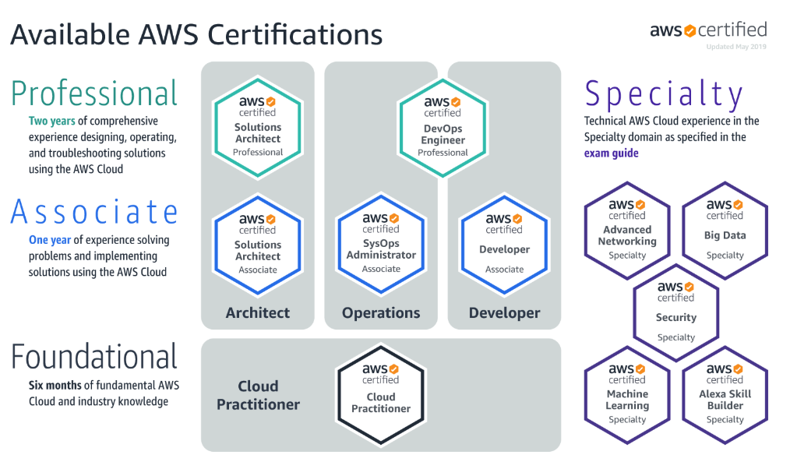
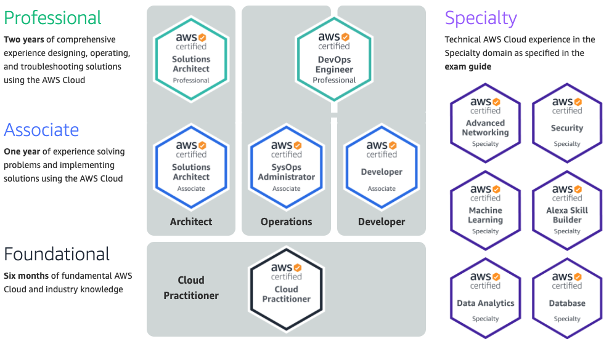
AWS Certification exams
This course helps prepare you for the AWS Certified Solutions Architect – Associate exam
The final module in this course discusses AWS certification in more detail.
Notes:
AWS Certification helps learners build credibility and confidence by validating their cloud expertise with an industry-recognized credential. It helps organizations identify skilled professionals who can lead cloud initiatives by using AWS.
You must earn a passing score on a proctored exam to earn an AWS Certification.
AWS Certification does not publish a list of all services or features that are covered in a certification exam. However, the exam guide for each exam lists the current topic areas and objectives that are covered in the exam. Exam guides can be found on the Prepare for Your AWS Certification Exam webpage.
You are required to update your certification (or recertify) every 3 years. View the AWS Certification Recertification page for more details.
The information on this slide is current as of June 2020. However, exams are frequently updated, and the details regarding which exams are available—and what is tested by each exam—are subject to change. For the latest AWS certification exam information, view the details on the AWS Certification webpage.
The final module in this course provides more information to supplement what you learn in this course. It will also guide you in how to apply this knowledge toward achieving the AWS Solutions Architect – Associate certification.

Slide 34
Module wrap-up
Module 1: Welcome to AWS Academy Cloud Architecting
Notes:
It’s now time to review the module.

Slide 35
Module summary
In summary, in this module, you learned how to:
Identify course prerequisites and objectives
Recognize the café business case
Indicate the role of cloud architects
Notes:
In summary, in this module, you learned how to:
Identify course prerequisites and objectives
Recognize the café business case
Indicate the role of cloud architects

Slide 36
Thank you
Notes:
Thank you for completing this module.

